Slide 1

Programming concepts apps
Jackie Sun

Slide 2
User persona
As a coder academy student, I want to journal the programming concepts we do in class, so that I can better remember/understand them.

Slide 3
Wireframe

Slide 4
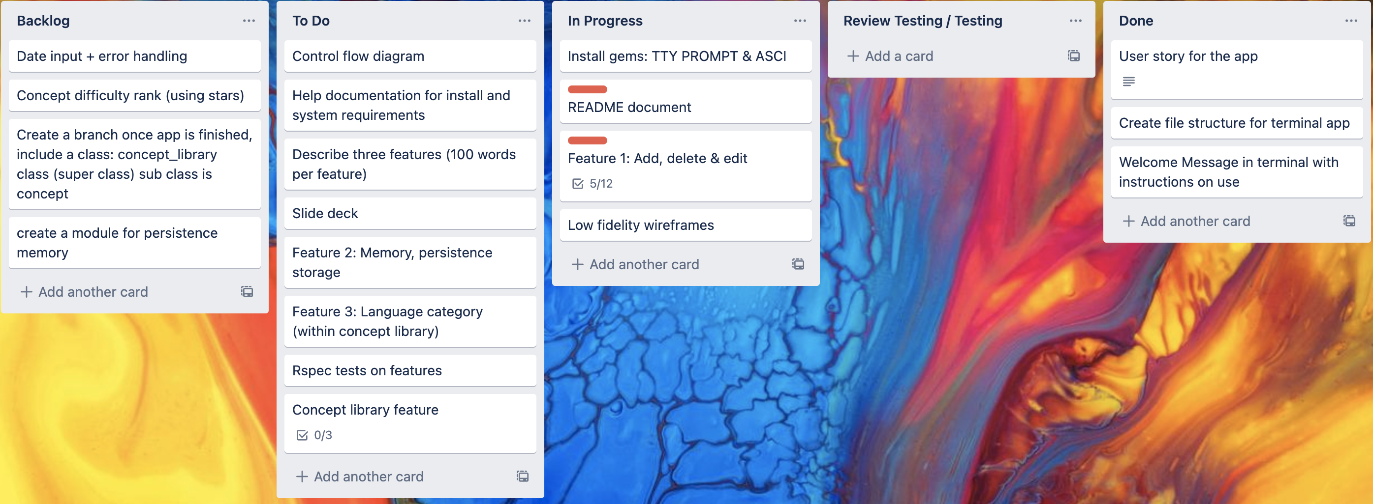
Trello Board

Slide 5
Issues
Error handling for characters that are not integers and integers that are outside the range
Infinite loops

